Slide 1
Jaringan Kerjasama Perpustakaan dalam menunjang Katalog Induk Daerah dan Bibiliografi Daerah
AMIRUL ULUM
FPPTI JAWA TIMUR
Dinas perpustakaan dan kearsipan propinsi jawa timur
Surabaya, 14 november 2018

Slide 2
Kapan Terakhir Anda Membaca Buku ini ?

Slide 3
Jaringan Kerjasama Perpustakaan Perguruan Tinggi
FKP2TN : Forum Komunikasi Perpustakaan Perguruan Tinggi Negeri
FPPTI : Forum Perpustakaan Perguruan Tinggi Indonesia
FPPTMA : Forum Perpustakaan Perguruan Tinggi Muhammadiyah dan Aisyiah
InCUVL : Indonesia Christian University Virtual Library
JPA APTIK : Jaringan Perpustakaa Asosiasi Perguruan Tinggi Katolik

Slide 4
FPPTI Jawa Timur
Resmi berdiri sejak Musyawarah Daerah Tahun 2010
Anggota = 214 Perguruan Tinggi
Terdiri dari :
Universitas = 70
Institut = 7
Sekolah Tinggi = 79
Akademi = 41
Politeknik = 17

Slide 5
Pengembangan Kerjasama
Prinsip Kerjasama
Kerjasama ini bertujuan untuk meningkatkan terpenuhinya kebutuhan koleksi perpustakaan yang ada sebagai sumber informasi tambahan baik koleksi buku teks dan koleksi digital di luar koleksi yang ada di masing-masing perpustakaan
Anggota FPPTI Jatim akan saling membantu dalam memenuhi kebutuhan koleksi perpustakaan, dengan prinsip saling menguntungkan.
Anggota FPPTI Jatim akan saling membantu dalam melaksanakan kerjasama ini sesuai dengan kemampuan dan ketersediannya koleksi dan kemampuan masing-masing pihak tanpa mengganggu pelaksanaan tugas dan fungsi perpustakaan masing-masing
Bentuk Kerjasama
Pelayanan informasi silang layan koleksi antar perpustakaan anggota FPPTI Jatim,
Kunjungan perpustakaan, sesuai aturan perpustakaan yang dikunjungi,
Pengembangan kompetensi pustakawan anggota melalui pelatihan dan seminar dengan narasumber maupun instuktur dari anggota.

Slide 6
Aktifitas
Kartu Super
Konsorsium e-journal dan e-book
Library Sharing Forum
Library Camp
Pendampingan Pengembangan Sistem Informasi Perpustakaan
Hosting Institutional Repository
Layanan pengecekan Similiarity/Antiplagiarism
Workshop, Seminar, Lokakarya bidang perpustakaan, kepustakawanan, teknologi informasi

Slide 7
Konsorsium E-journal FPPTI Jatim :
Subyek Ekonomi : 31 anggota
Subyek Humaniora : 28 anggota
Subyek Kesehatan : 37 anggota
Subyek Teknik : 26 anggota
Konsorsium E-Book FPPTI Jatim :
Subyek Ekonomi : 9 anggota
Subyek Humaniora : 6 anggota
Subyek Teknik : 3 anggota
Konsorsium Plagscan FPPTI Jatim : 10 perguruan tinggi
Layanan Hosting Repositori FPPTI Jatim : 13 perguruan tinggi

Slide 8
Katalog Induk dan Bibliografi Daerah
UU NO 4 TAHUN 1990 TENTANG SERAH-SIMPAN KARYA CETAK DAN KARYA REKAM
BAB II
KEWAJIBAN SERAH-SIMPAN KARYA CETAK DAN KARYA REKAM
Pasal 2
Setiap penerbit yang berada di wilayah negara Republik Indonesia, wajib menyerahkan
2 (dua) buah cetakan dari setiap judul karya cetak yang dihasilkan kepada
Perpustakaan Nasional, dan sebuah kepada Perpustakaan Daerah di ibukota propinsi
yang bersangkutan selambat-lambatnya 3 (tiga) bulan setelah diterbitkan.
UU NO 43 TAHUN 2007 TENTANG PERPUSTAKAAN
BAB IV KOLEKSI PERPUSTAKAAN
Pasal 13
(1) Koleksi nasional diinventarisasi, diterbitkan dalam bentuk katalog induk nasional (KIN), dan didistribusikan oleh Perpustakaan Nasional.
(2) Koleksi nasional yang berada di daerah diinventarisasi, diterbitkan dalam bentuk katalog induk daerah (KID), dan didistribusikan oleh perpustakaan umum provinsi.

Slide 9
PENGEMBANGAN KID dan BD

Slide 10
The Value
selection and acquisition in libraries and similar institutions
cataloguing (both directly for copy cataloguing and indirectly for cataloguing support)
verification of authorship and publication history
give the statistical account of a country’s publishing output
provide evidence of the impact of government policies in relation to education, language,economic programmes, etc.
reveal the extent of a country’s self sufficiency in producing the publications it requires
Žumer, Maja (2008). Guidelines for National Bibliographies in the Electronic Age :
IFLA Working Group on Guidelines for National Bibliographies

Slide 11
The Users
End-users
Formal or informal groups
Corporate bodies
Commercial product (UK)
Working Group

Slide 12
The Use
Librarians
Cataloguers ; for copy cataloguing, for authority records (names, corporate bodies)
Acquisitions librarians; to order publications, identify publishers and distributors, publication status.
Collection development librarians ; To analyse available publications, to select according to collection development criteria, also awareness of future publications
Reference librarians ; They act on behalf of end-users (including library patrons, formal and informal groups, and corporate bodies)
Legal deposit management ; used to analyse and control the deposit.
Preservation librarians ; To determine trends in publishing and plan preservation procedures
Digitisation decisions ; To get an overview of materials and make informed decisions on digitisation priorities.

Slide 13
Book trade (including other media)
Publishers ; Commercial and non-commercial sector, also government and official publishers use national bibliographies to analyse the market and competition
Booksellers (including other media vendors); In their needs this group is similar to collection development and acquisition librarians. In addition they may perform the function of a reference librarian and possibly even refer customers to libraries for out-of-print publications.
Agencies
Funding bodies ; To study the impact of existing funding or to plan future funding policies.
Official statistics ; For statistical account of a country’s publishing output.

Slide 14
Rights management organisations
Because of high-quality authority control and authoritative data on authorship national bibliography data can be (and is) used to support management of intellectual rights by collecting societies, but also government bodies for management of lending right remuneration.
Others
Printers identifying publishers to offer cooperation
Journalists to identify language/genre/origin patterns in publications
Organizers of book fairs
identification of translators from/to specific language
Identification of illustrators.

Slide 15
Information for users
Searching and display :
author name (any form)
title words
language/country of publication
Publisher
publication year
subject headings or keywords
publication type/genre/format
Standart identifier (ISSN, ISBN, ISMN)
Address and contact for publisher (Acquisition and booksellers)
Price (Acquisition and booksellers)
Availability (Acquisition and booksellers)
Rights (Acquisition and booksellers)

Slide 16
Computer software
(federated searching, distributed searching, harvesting)
Many national libraries are offering their users seamless access to all their information sources via information retrieval portals. In addition to national portals there are new international initiatives. To enable the searching, there are technically two different approaches:
Distributed searching using traditional Z39.50
Central index, created and maintained by harvesting with OAI-PMH

Slide 17
SILAS the Singapore national bibliographic network
SILAS is a membership organisation managed by National Library Board of Singapore (48 member libraries), three core functions:
Provides cooperative cataloguing services to our member libraries. We use OCLC WorldCat Connexion Services to support this function.
Organises events and activities to keep up the knowledge and competence of cataloguing librarians in the community.
SILAS participates in the NACO program from Library of Congress (Name Authority Cooperative Program, disc., 1 July 2018).
1982 : proposals made by the Library Association of Singapore
1985 : a licensing agreement for software to run such a service was signed with the Western Library Network in August 1985.
10 April 1987 : officially launched

Slide 18
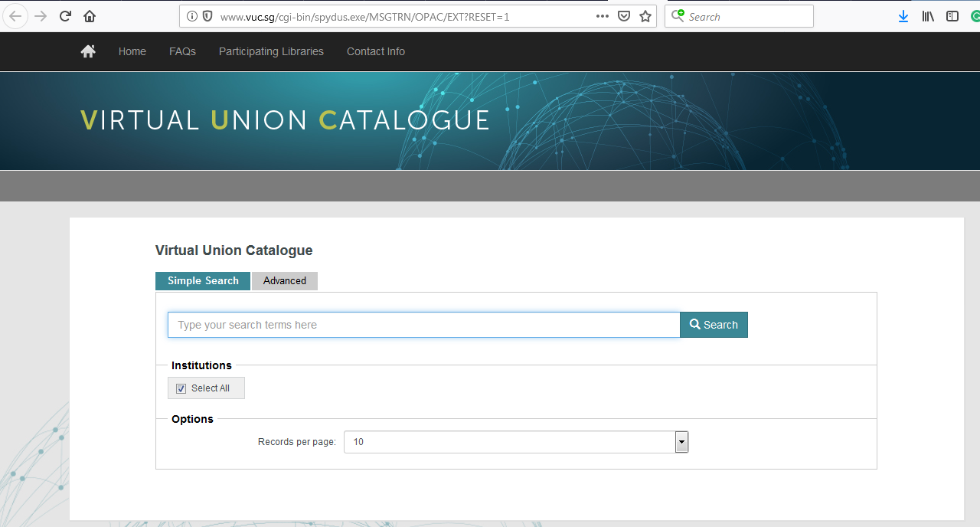

Slide 19
Participating Libraries
Institute of Southeast Asian Studies (ISEAS)
Management Development Institute Of Singapore (MDIS)
Nanyang Technological University (NTU)
National Institute of Education (NIE)
National Library Board (NLB)
National University Of Singapore (NUS)
Ngee Ann Polytechnic (NP)
Regional Language Centre (RELC)
Republic Polytechnic (RP)
Singapore Institute of Management (SIM)
Singapore Management University (SMU)
Singapore Polytechnic (SP)
Temasek Polytechnic (TP)

Slide 20
PublicationSG
to preserve materials published in Singapore and deposited with NLB for posterity
to aid libraries in the selection and acquisition of new materials for collection development
to serve as reference source for access by librarians, researchers and bibliographer

Slide 21
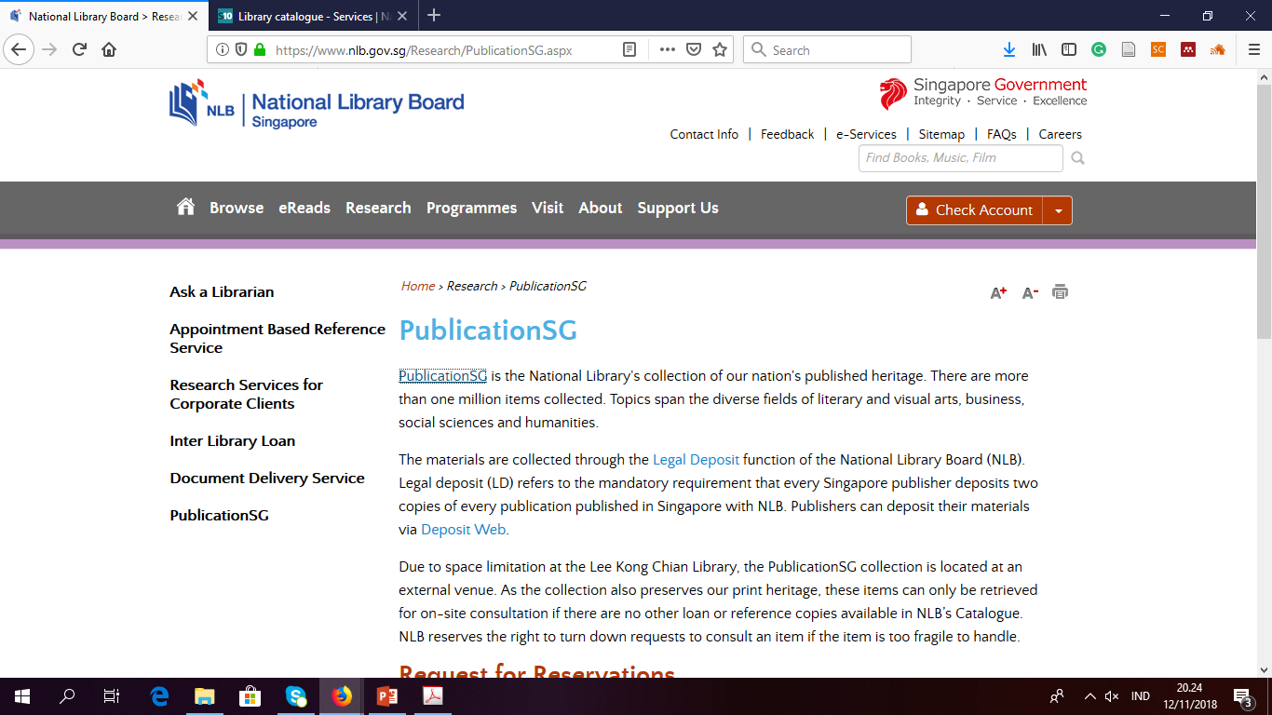

Slide 22
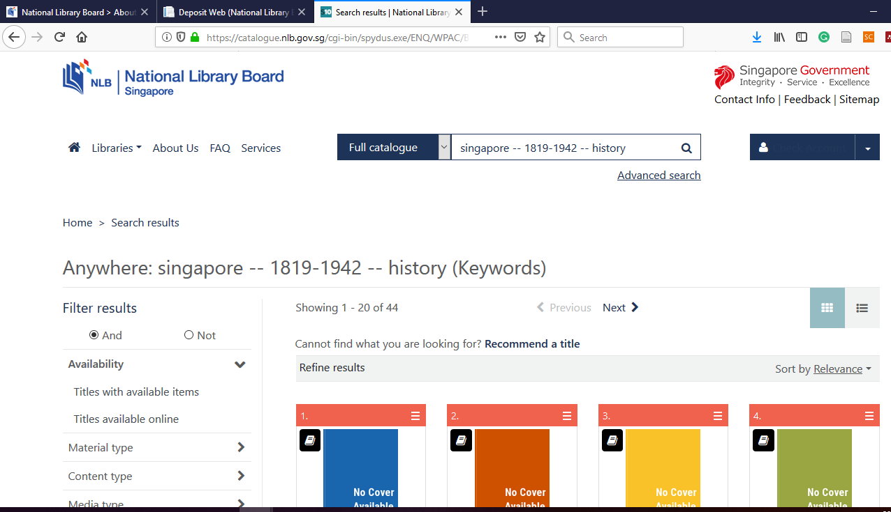

Slide 23
PERMASALAHAN
Perpustakaan tidak dapat memenuhi semua kebutuhan Pemustaka
Persepsi urgensi Katalog Induk Daerah
Lingkup layanan masing-masing jenis perpustakaan
Perbedaan platform sistem informasi perpustakaan
Pengembangan sistem informasi perpustakaan belum sepenuhnya berbasis jejaring
Penggunaan stardar katalogisasi dan metadata yang berbeda
Kesepakatan kerjasama, mekanisme dan pembiayaan

Slide 24
Pengembangan KID dan BD di Jawa Timur
Keterlibatan Perpustakaan Perguruan Tinggi dengan Perpustakaan Kota/Kabupaten setempat melalui jejaring yang sudah berkembang
Pemanfaatan teknologi informasi (harvesting / interoperabilitas)
Pengumpulan data terintegrasi secara regional dan nasional (Onesearch, MILL)
Membentuk Working Group, Konsorsium dan sejenisnya
Sosialisasi dan Monitoring
Keberlanjutan

Slide 25
Kerjasama Perpustakaan PT dengan Perpustakaan Kabupaten/Kota
Kerjasama untuk menerbitkan pustaka yang terkait kekayaan dan budaya lokal
Membangun jejaring untuk aktifitas pengadaan koleksi, pemanfaatan koleksi bersama
Pemanfaatan teknologi informasi dalam mengembangkan jejaring
Pembentukan Working Group dan Focus Group Discussion untuk beberapa aktifitas bersinergi
Peningkatan kompetensi pustakawan

Slide 26
Referensi
Andresoo, Janne, 2001. The National Bibliography Concept in a Changing Information Environment. Libraries and Librarians: Making a Difference inthe Knowledge Age. Council and General Conference:Conference Programme and Proceedings
Kismiyati, Titiek. 2016. Kebijakan dan Rencana Kerja Perpustakaan Nasional RI Dalam Tata Kelola Internet Di Indonesia
Parent, Ingrid, 2007. The Importance of National Bibliographies in the Digital Age. World Library And Information Congress : 73rd IFLA General Conference And Council
Saleh, Sauliah, Nurwati, Tangkawarow, Stansye A. 2012. Pedoman penyusunan bibliografi daerah dan katalog induk daerah. Jakarta : Perpustakaan Nasional RI.
Sulistyo-Basuki, 2015. Katalog Induk nasional Tercetak dan Elektronik pada Abad 21a Undang-Undang No 4 Tahun 1990 Tentang Serah-Simpan Karya Cetak dan Karya Rekam
Undang-Undang No 43 Tahun 2007 Tentang Perpustakaan
Žumer, Maja (ed.), 2008. Guidelines for National Bibliographies in the Electronic Age : IFLA Working Group on Guidelines for National Bibliographies

Slide 27
TERIMA KASIH
AMIRUL ULUM
FPPTI Jawa Timur
Pustakawan Universitas Surabaya
amirul@staff.ubaya.ac.id
0818 5196 36

