Slide 1
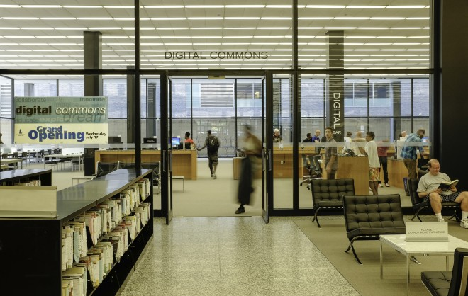
Photo by Phil Freelon sumber:districtdispatch.org (2015)
Notes:
Job Skills-specific computer training, assistance infinding and applying jobs. Uji coba tablet sebelum beli, bertemu librarian untuk cetak buku (self-publishing).

Slide 2
Pustakawan?
What Should I do?
Kenali pengguna anda, bisa dilakukan dengan environment scanning
Lakukan hal sederhana yang bisa dilakukan terlebih dahulu
Kolaborasi / partnership
Tetap belajar dan mengikuti perkembangan yang ada, termasuk technical skills hardware yang ada
Notes:
One county library might have the fanciest video studio that money
can buy; the next one over might have an even happier group of creative
people working strictly with pencils, wood, paper, and clay.

Slide 3
Librarycloud (2015)
“library is the center
of public happiness first, of public education next.”
(Hamilton & Schmidt, 2015)
Notes:
“happiness usually
involves following through on one’s interest” to “not only being able to
follow up with my interest but also doing something about it” to the notion
that libraries’ “intentions always have been to support people’s learning.
And some of that learning is much more effective when combined with
doing”

Slide 4
Bibliography
Bennett, S. (2003). Libraries designed for learning. Washington, DC: Council on Library and Information Resources. Retrieved from http://www.clir.org/pubs/abstract/pub122abst. html
Horrigan, J. (2015). Libraries at the crossroads. Pew Research Center. Retrieved from http://www.pewinternet.org/files/2015/09/2015-09-15_libraries_FINAL.pdf
Johnson, E. D. M. (2016). The right place at the right time: Creative spaces in libraries. In Advances in Library Administration and Organization (Vol. 36, pp. 1–35).
Jones, C. (2012). A WAPL recap. Blog Post, May 13. Retrieved from ttp://www.libraryasincubatorproject.
org/?p=4594
Khoir, Safirotu (2017). Past, present and future: Menuju perpustakaan yang terhubung. Prosiding Eksistensi Perpustakaan: Masa SIlam, Era Kekinian, dan Masa Depan, 1-13.
Weinberger, D. (2012, November 1). Library as platform: Creating an infrastructure for the circulation of ideas and passions. Library Journal, 137(18), 34.
Wurdinger, S. D., & Carlson, J. A. (2010). Teaching for experiential learning: Five approaches that work. Lanham, MD: Rowman & Littlefield Education.

Slide 5
Thank You!
bit.ly/makerspace1018

Slide 6
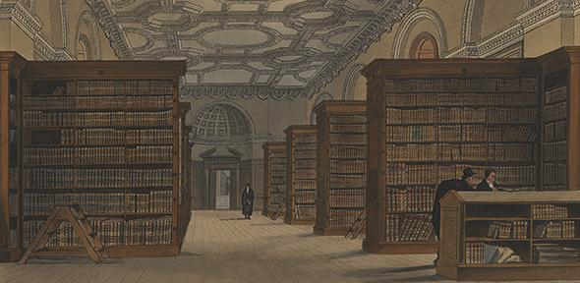
bit.ly/
Sumber: Cambridge University Library

Slide 7
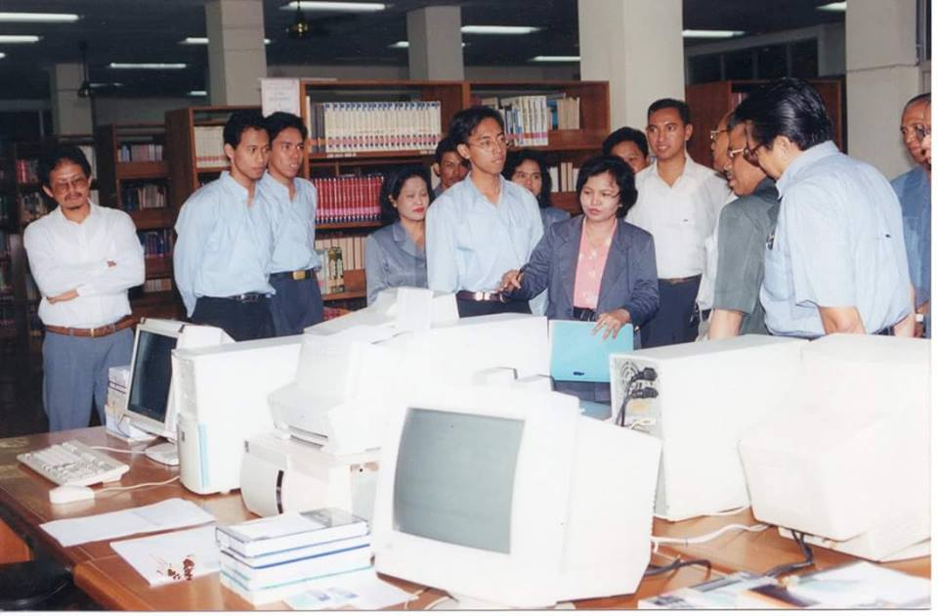
Sumber: Facebook Ibu Welmin

Slide 8
